Slide 1
RISC & CISC Architecture
RISC: REDUCED INSTRUCTION SET COMPUTERS.
In RISC instruction are bare as minimum possible to allow the user to design its own application. (We can say that 8085 is RISC processor)
Ex: - MOV B,A
LDA 2000 H
MUL B (First transfer the data from B to A, then Multiply)
CISC: COMPLEX INSTRUCTION SET COMPUTERS.
In CISC processor there tends to be large number of instructions, each carrying out a different permutation of the same operations. (We can say that 8086 is CISC processor)
Ex: - MUL AX, BX (Direct Multiplication can take place)
In general it is observed that RISC are faster then CISC. But, there are some CISC processor which are faster then RISC. i.e. we cannot say always that this one is faster.

Slide 2
Microprocessor v/s Microcontrollers
Microcontroller
A microcontroller (also microcomputer, MCU or µC) is a small computer on a single integrated circuit consisting internally of a relatively simple CPU, clock, timers, I/O ports, and memory. Microcontrollers are designed for small or dedicated applications. Thus, in contrast to the microprocessors used in personal computers and other high-performance or general purpose applications
Microprocessor
A microprocessor incorporates most or all of the functions of a computer's central processing unit (CPU) on a single integrated circuit. The first microprocessors emerged in the early 1970s and were used for electronic calculators, using binary-coded decimal (BCD) arithmetic on 4-bit words. Other embedded uses of 4- and 8-bit microprocessors. Affordable 8-bit microprocessors with 16-bit addressing also led to the first general purpose microcomputers in the mid-1970s

Slide 3
Embedded Vs External Memory Devices
Embedded Devices (Microcontroller): -
8051 Microcontroller
AVR Microcontroller
PIC Microcontroller
ARM Microcontroller
External Memory Devices (Microprocessor): -
1. 8085 Microprocessor
2. 8086 Microprocessor
3. 80186 Microprocessor
4. 80286 Microprocessor
5. 80386 Microprocessor

Slide 4
Evolution of Processor
4004:
4-bit microprocessor. 4KB main memory.
45 instructions. PMOS technology. 50 KIPS
8008: (1971)
8-bit version of 4004. 16KB main memory.
48 instructions. NMOS technology.
8080: (1973)
8-bit microprocessor. 64KB main memory.
2 microseconds clock cycle time; 500,000 instructions/sec. 10X faster than 8008.
8085: (1977)
8-bit microprocessor - upgraded version of the 8080, 64KB main memory, 1.3 microseconds clock cycle time; 769,230, instructions/sec, 246 instructions, Intel sold 100 million copies of this 8-bit microprocessor.
8086: (1978) 8088 (1979)
16-bit microprocessor, 1MB main memory, 2.5 MIPS (400 ns).
4- or 6-byte instruction cache, Other improvements included more registers and additional instructions.
80286: (1983)
16-bit microprocessor very similar in instruction set to the 8086.
16MB main memory, 4.0 MIPS (250 ns/8MHz).

Slide 5
8051 Architecture
8051 is a general purpose 8 bit micro controller. 8 bit means its data bus & CPU is
8 bit wide. Intel 8051 micro controller was designed by the company Intel. But is
rarely available & costly also. Therefore most of the company are using Atmel
89C51/89C52/89S51/89S52 microcontroller
Major companies manufacturing the 8051 series micro controller : -
Intel / Atmel / Philips / Motorola / Dallas
Main features of 8051 series micro controller: -
40 pin IC package DIP (Dual in line package)
4K byte of flash memory (EEPROM) 000 H to FFF H
128 byte of RAM 00H to 07 F
4 Port, P0, P1, P2, P3 Each port of 8 bits, like P10, P11,P12, P13, P14, P15, P16 P17
2 Timers T0, T1 2 Counters 1 Serial Communication (UART)
Atmel 89C51 4K, 128, 2 Timer (4K Means 000H to FFFH)
Atmel 89C52 8K, 256, 3 Timer (8K Means 0000H to 1FFFH)
Atmel 89S51 4K, 128, 2 Timer, 1 Watch dog timer
Atmel 89S52 8K, 256, 3 Timer, 1 Watch dog timer

Slide 6
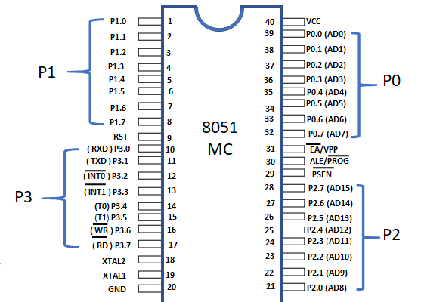
Pin diagram

Slide 7
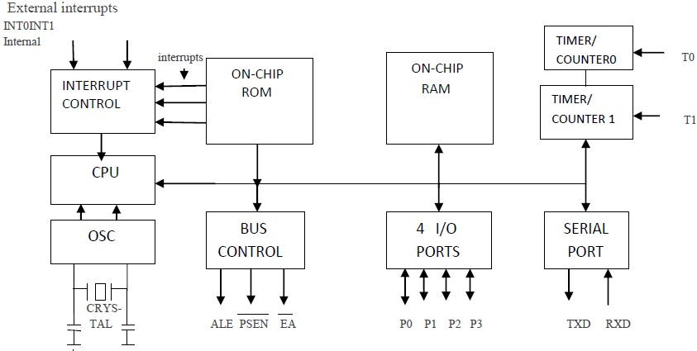
8051 Architecture

Slide 8
Memory Organization of 8051: -
The first 8 bytes (00h - 07h) are "register bank 0". Bit memory resides in internal
RAM, from addresses 20h through 2Fh. The 80 bytes remaining of Internal RAM,
from addresses 30h through 7Fh, may be used by user variables that need to be
Accessed frequently or at high-speed. This area is also utilized by the
microcontroller as a stack.
Start address | Register name |  |  |  |  |  |  |  | End Address
00H | R0 | R1 | R2 | R3 | R4 | R5 | R6 | R7 | 07H | Register bank 0
08H | R0 | R1 | R2 | R3 | R4 | R5 | R6 | R7 | 0FH | Register bank 1
10H | R0 | R1 | R2 | R3 | R4 | R5 | R6 | R7 | 17H | Register bank 2
18H | R0 | R1 | R2 | R3 | R4 | R5 | R6 | R7 | 1FH | Register bank 3
20H | Bit addressable |  |  |  |  |  |  |  | 27H
28H | Bit addressable |  |  |  |  |  |  |  | 2FH
30H | General purpose RAM |  |  |  |  |  |  |  | 7FH

Slide 9
Special Function Register Of 8051 Microcontroller: -
Port 0 Port1
Port2 Port3
SCON SBUF
Stack Pointer (SP)
DPTR (DPL and DPH)
PCON PSW
Accumulator B
TMOD
TL0 TL1
TH0 TH1

Slide 10
The Data Pointer (DPTR): -
The Data Pointer (DPTR) is the 8051s only user-accessable 16-bit (2-byte) register. The Accumulator, "R" registers, and "B" register are all 1-byte values. DPTR, as the name suggests, is used to point to data. It is used by a number of commands which allow the 8051 to access external memory. When the 8051 accesses external memory it will access external memory at the address indicated by DPTR.
The Program Counter (PC) : -
The Program Counter (PC) is a 2-byte address which tells the 8051 where the next instruction to execute is found in memory. When the 8051 is initialized PC always starts at 0000h and is incremented each time an instruction is executed.
The Stack Pointer (SP) : -
The Stack Pointer, hold an 8-bit (1-byte) value. When we push a value onto the stack, the 8051 first increments the value of SP and then stores the value at the resulting memory location. During pop a value off the stack, the 8051 returns the value from the memory location indicated by SP, and then decrements the value of SP.

Slide 11
Program status (PSW) word of 8051: -
Cy Carry Ac Auxiliary carry P Parity
Cy Ac x RS1 RS0 OV x P
RS1 RS0
0 0 Bank 0
0 1 Bank 1
1 0 Bank 2
1 1 Bank 3
The user may make use of 128 byte memory variables with commands such as
SETB and CLR.
For example, to set bit number 24 (hex) to 1 you would execute the instruction:
SETB 24h

Slide 12
Disclaimer:
Proposed notes in the PPT are for your reference and for more detail description kindly refer the text books and reference books of the syllabus.
As per the new guidelines MTE/ETE question paper may be from the external agency. Therefore, it is requested to prepare yourself through the suggested reading materials in the syllabus also.

